Slide 1

Prediction of Diabetes
DSC 630 – Final
Krystina Moses

Slide 2
Introduction/Background
This project looks at diabetes and determines the likelihood of development as well as how much the amount of people with the disease has changed over the years.
There are a few different types of diabetes known and each one treated in it’s own way. While some may not be preventable, this disease impacts the lives of many each year with diagnosis, complications, and death. There are many that go undiagnosed as well. There is information out there that Type 2 diabetes can be prevented with lifestyle changes and the lifestyle changes are also important when diagnosed with Gestational diabetes.

Slide 3
Data
The dataset covers many factors including glucose, BMI, age, number of pregnancies, and blood pressure . It is also used to determine if a person will have diabetes.
https://www.kaggle.com/uciml/pima-indians-diabetes-database
A brief look at the data:
 | Pregnancies | Glucose | Blood Pressure | Skin Thickness | Insulin | BMI | Diabetes Pedigree Function | Age | Outcome
0 | 6 | 148 | 72 | 35 | 0 | 33.6 | 0.627 | 50 | 1
1 | 1 | 85 | 66 | 29 | 0 | 26.6 | 0.351 | 31 | 0
2 | 8 | 183 | 64 | 0 | 0 | 23.3 | 0.672 | 32 | 1
3 | 1 | 89 | 66 | 23 | 94 | 28.1 | 0.167 | 21 | 0
4 | 0 | 137 | 40 | 35 | 168 | 43.1 | 2.288 | 33 | 1

Slide 4
Dataset Description
Pregnancies: # of times pregnant
Glucose: Plasma glucose concentration a 2 hours in an oral glucose tolerance test
Blood Pressure: Diastolic blood pressure (mm Hg)
Skin Thickness: Triceps skin fold thickness (mm)
Insulin: 2-Hour serum insulin (mu U/ml)
BMI: Body mass index (weight in kg/(height in m)^2)
Diabetes Pedigree Function: a function that represents how likely they are to get the disease by extrapolating from their family history
Age: Age in years
Outcome: Class variable (0: non-diabetic, 1: diabetic)

Slide 5
Data Preparation / Exploratory Data Analysis
Verifying the data had no missing or NaN values
Renaming columns to ensure they were all the same format and for easy reading
Verifying the type of information on the dataset
Data visualizations to better understand the data

Slide 6
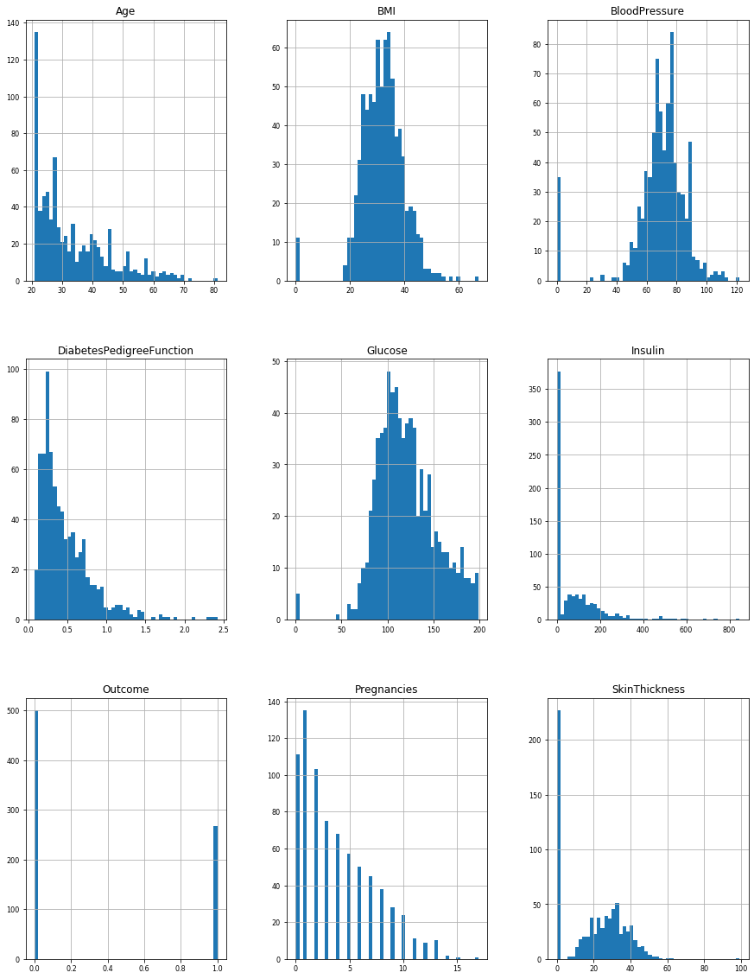
Graphs for each variable

Slide 7
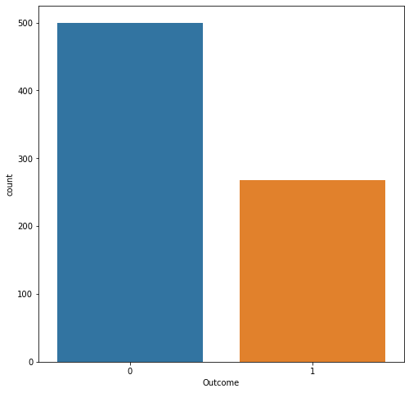
OUTCOME – TARGET VARIABLE
Non diabetic is represented as zero and has 500 values
Diabetic is represented as one and has 268 values

Slide 8
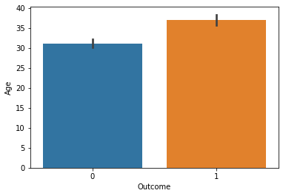
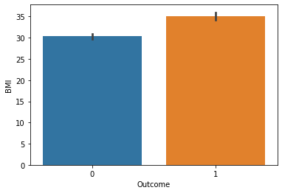
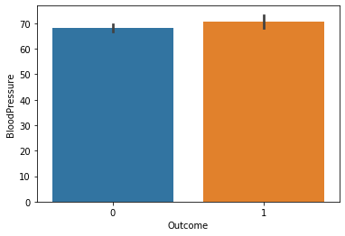
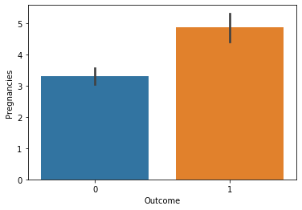
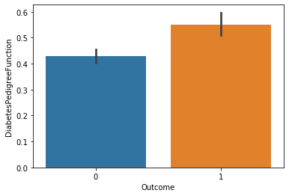
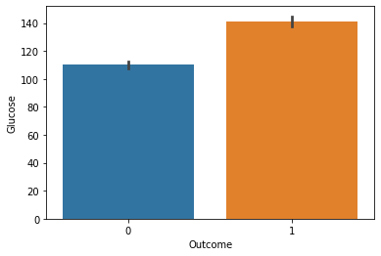
Other variables in relation to outcome

Slide 9
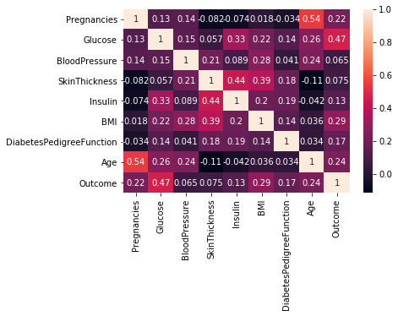
Understanding the data
A correlation matrix was created to see the relationship between the variables. This determined that Glucose had the closet relationship to a person who had diabetes with BMI as the next closest.

Slide 10
Models
 | Logistic Regression | SVC | Random Forest
F1 Score | 0.38 | 0.39 | 0.42
Precision Score | 0.32 | 0.33 | 0.43
Recall Score | 0.47 | 0.50 | 0.47
Accuracy | 0.62 | 0.65 | 0.59
Use models to determine the likelihood of diabetes and the most common factor
Support Vector Classifier came out with the best accuracy.

Slide 11
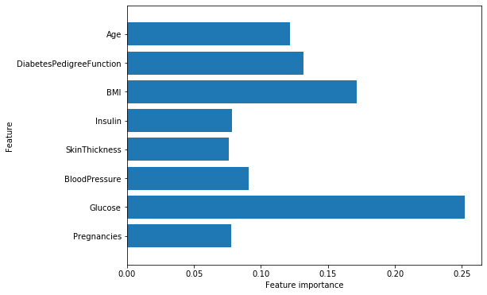
Results/conclusion
It was determined that Glucose has the highest importance in determining if one has diabetes.
This is also the case for Age, BMI, and Diabetes Pedigree Function.

Slide 12
References
Diabetes. (2020, February 18). Retrieved from https://www.cdc.gov/diabetes/library/socialmedia/infographics/diabetes.html
Diabetes Overview. (n.d.). Retrieved from https://www.diabetes.org/diabetes
Diabetes Prediction - dataset by informatics-edu. (2019, August 27). Retrieved from https://data.world/informatics-edu/diabetes-prediction/workspace/file?filename=Diabetes+Registry.CSV+-+Introduction+to+Biomedical+Data+Science.csv
Gestational diabetes. (2020, February 27). Retrieved from https://www.mayoclinic.org/diseases-conditions/gestational-diabetes/symptoms-causes/syc-20355339
National Diabetes Statistics Report. (2020, February 14). Retrieved from https://www.cdc.gov/diabetes/data/statistics/statistics-report.html
U.S. Diabetes Surveillance System. (n.d.). Retrieved from https://gis.cdc.gov/grasp/diabetes/DiabetesAtlas.html#

